Slide 1
Model Diagnostic and Model Selection
Statistical Data Analysis, 2023

Slide 2


Slide 3
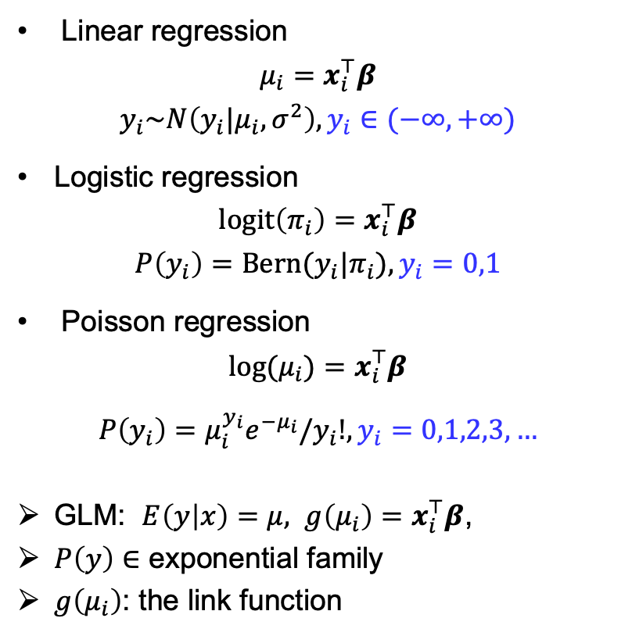
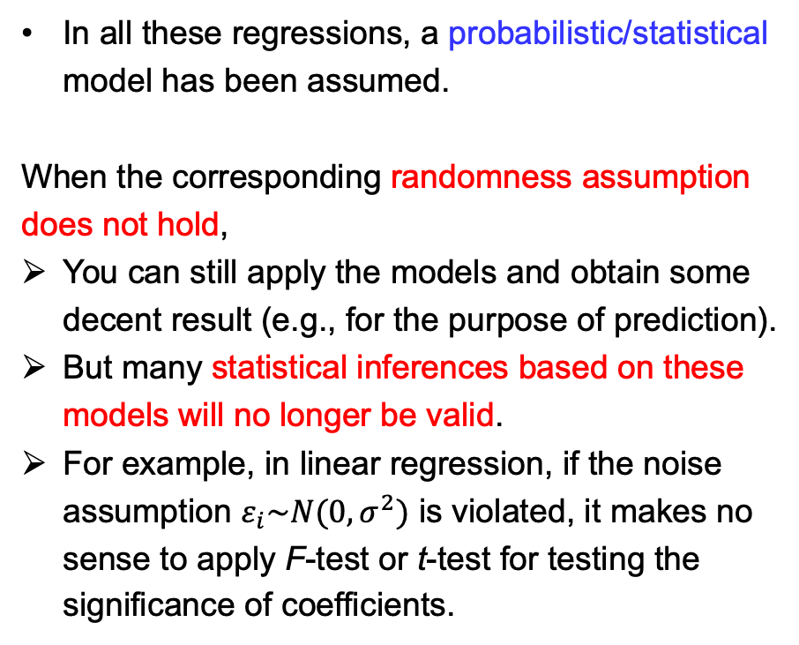
Generalized Linear Models (which we’ve seen)
Linear regression
$$μ_{i}=x_{i}^{⊤}β$$
$$y_{i}\sim N\left(y_{i}|μ_{i},σ^{2}\right),y_{i}∈(−∞,+∞)$$
Logistic regression
$$\operatorname{logit}\left(π_{i}\right)=x_{i}^{⊤}β$$
$$P\left(y_{i}\right)=Bern(y_{i}|π_{i}),y_{i}=0,1$$
Poisson regression
$$\log{(μ_{i})}=x_{i}^{⊤}β$$
$$P\left(y_{i}\right)=μ_{i}^{y_{i}}e^{−μ_{i}}/y_{i}!,y_{i}=0,1,2,3,…$$
GLM: $E\left(y | x\right)=μ, g\left(μ_{i}\right)=x_{i}^{⊤}β$,
$P\left(y\right)∈$ exponential family
$g\left(μ_{i}\right)$: the link function
In all these regressions, a probabilistic/statistical model has been assumed.
When the corresponding randomness assumption does not hold,
You can still apply the models and obtain some decent result (e.g., for the purpose of prediction).
But many statistical inferences based on these models will no longer be valid.
For example, in linear regression, if the noise assumption $ε_{i}\sim N(0,σ^{2})$ is violated, it makes no sense to apply F-test or t-test for testing the significance of coefficients.
Notes:
If we want to use the tool of stat inference, we must test the modelling assumptions.

Slide 4
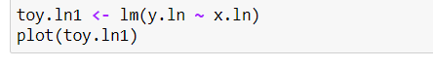
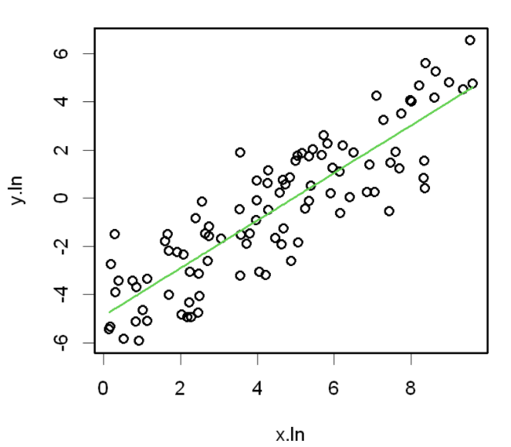
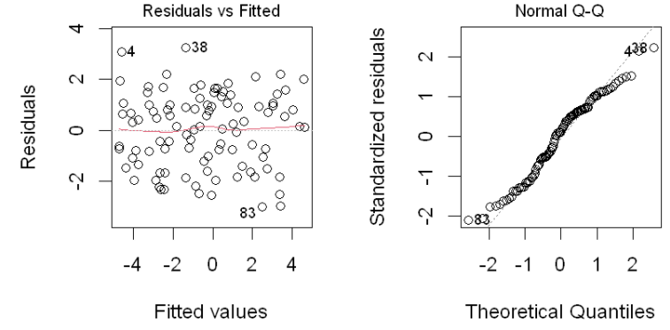
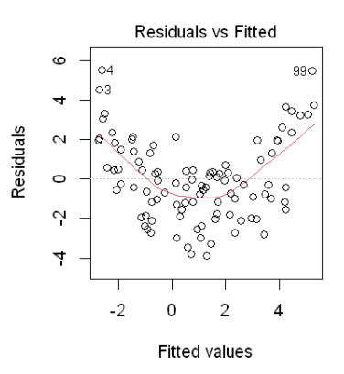
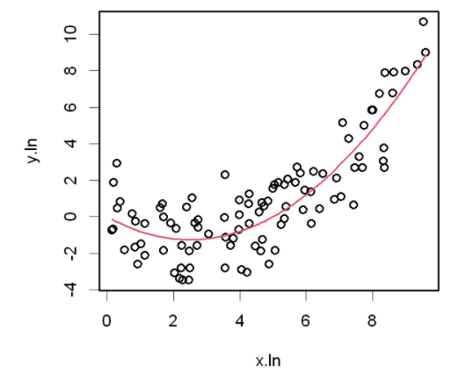
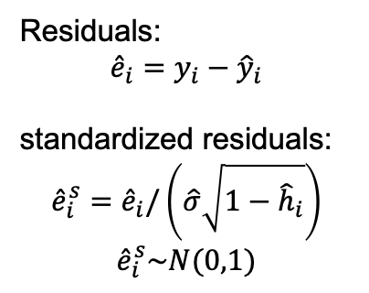
Residual plots — Linear regression
Residuals:
$${\hat{e}}_{i}=y_{i}−{\hat{y}}_{i}$$
standardized residuals:
$${\hat{e}}_{i}^{s}={\hat{e}}_{i}/\left(\hat{σ}\sqrt{1−{\hat{h}}_{i}}\right)$$
$${\hat{e}}_{i}^{s}\sim N(0,1)$$
In linear regression, the residual plots (e.g., residuals v.s. fitted, residual v.s. explanatory, distribution of standardized residuals, etc…) are very useful for model diagnostic.
Notes:
Linear trend and non-linear trend of data.

Slide 5
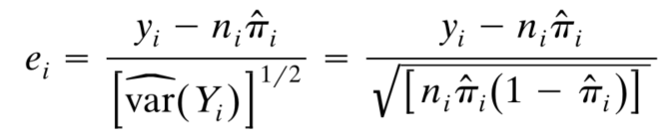
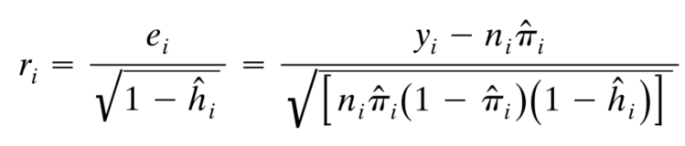
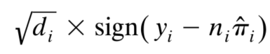
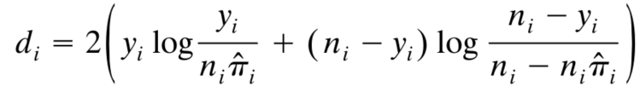
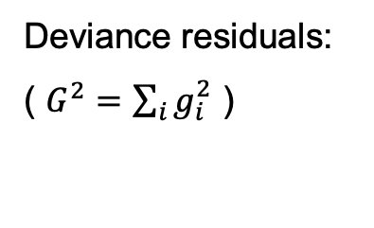
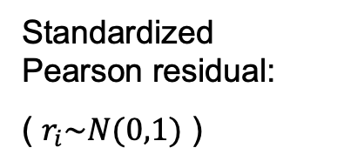
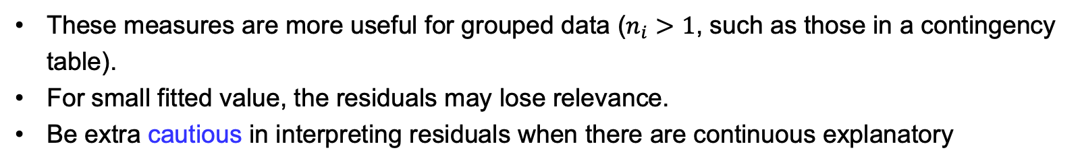
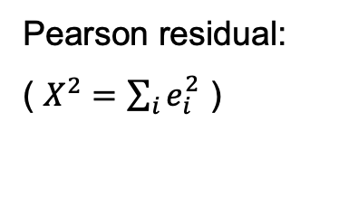
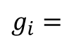
Logistic Regression — Local lack-of-fit measure
Pearson residual:
( $X^{2}=\sum_{i}{e_{i}^{2}}$ )
Standardized Pearson residual:
( $r_{i}\sim N(0,1)$ )
Deviance residuals:
( $G^{2}=\sum_{i}{g_{i}^{2}}$ )
$$g_{i}=$$
These measures are more useful for grouped data ($n_{i}>1$, such as those in a contingency table).
For small fitted value, the residuals may lose relevance.
Be extra cautious in interpreting residuals when there are continuous explanatory

Slide 6
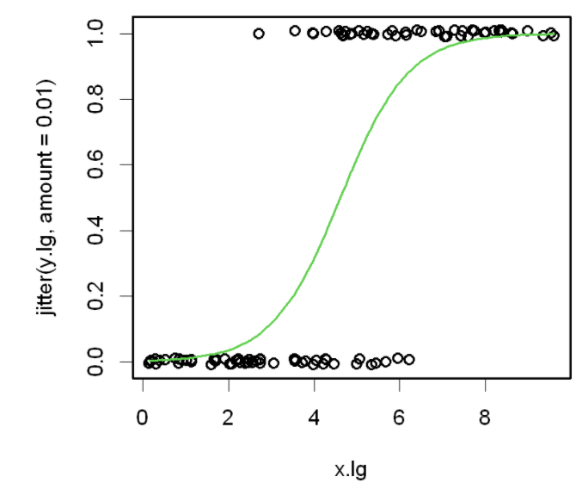
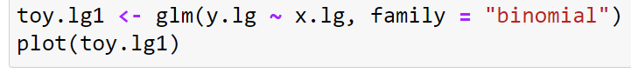
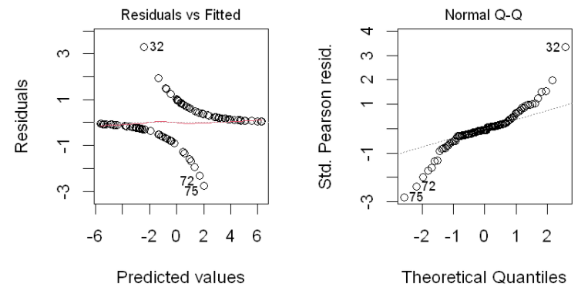
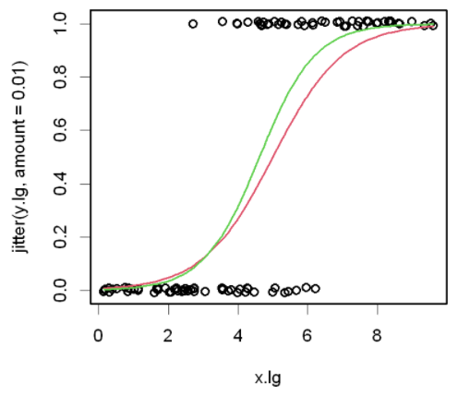
Residual plots — Logistic regression
For small fitted value, the residuals may lose relevance.
Red: ground truth
Green: fitted
These two residual plots looks strange, but in fact they are fine.
The residual plots are NOT so informative for logistic regression, in the presence of continuous explanatory.
On the other hand, no need to rely on them to check noise assumption (like heteroskedasticity in linear regression).

Slide 7
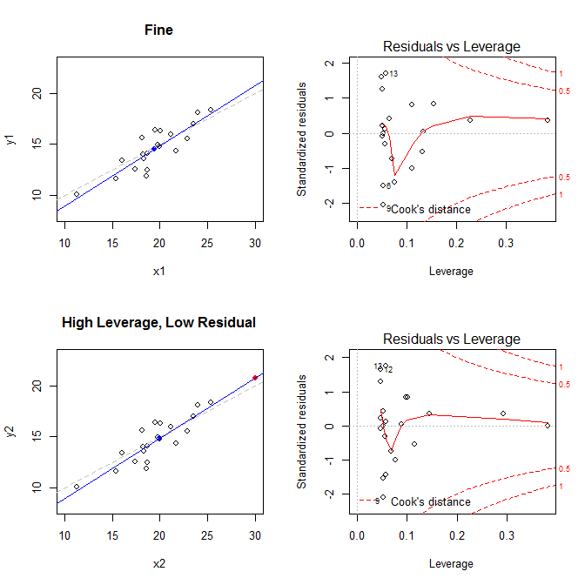
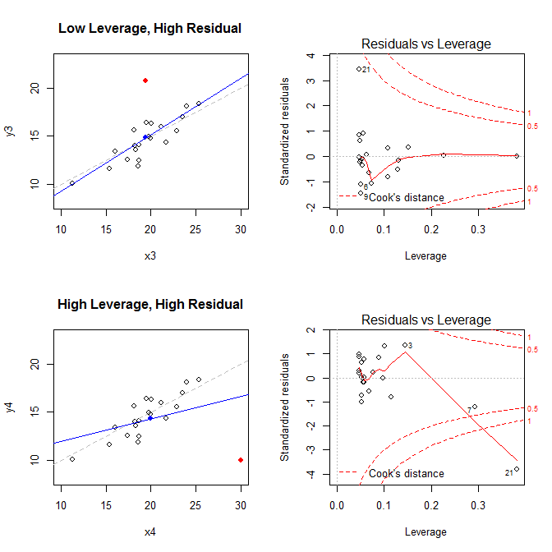
Unusual observations
"Unusual" observations can have dramatic effects on estimates in ALL linear models
Can change the coefficients for the predictors
Can change the predicted values for all observations
Three archetypal cases:
Typical x (low leverage), bad fit (high residual) — Not much harm
Unusual x (high leverage), good fit (low residual) — Not much harm
Unusual x (high leverage), bad fit (high residual) — Bad for the model
(but may be a good source for a new project!)
Influential observations: unusual in x and y

Slide 8
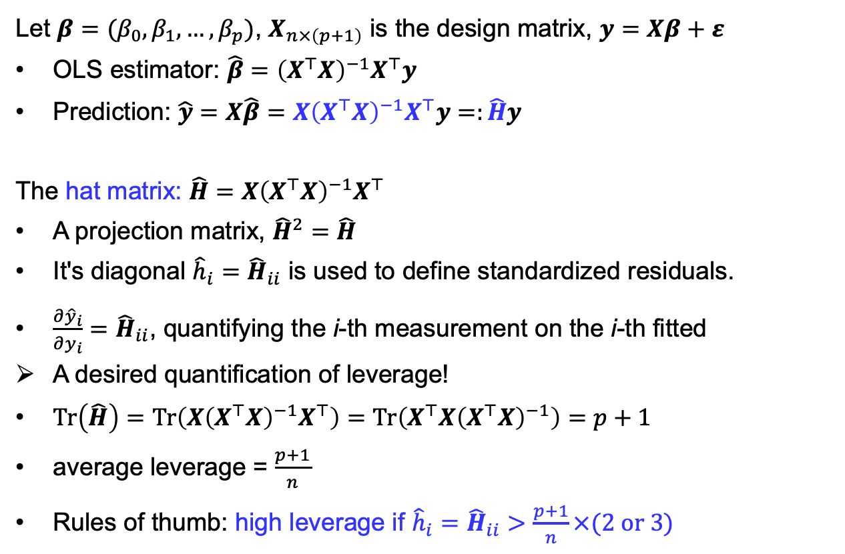
Leverage in linear regression
Let $β=(β_{0},β_{1},…,β_{p})$, $X_{n×\left(p+1\right)}$ is the design matrix, $y=Xβ+ε$
OLS estimator: $\hat{β}={\left(X^{⊤}X\right)}^{−1}X^{⊤}y$
Prediction: $\hat{y}=X\hat{β}=X{\left(X^{⊤}X\right)}^{−1}X^{⊤}y=:\hat{H}y$
The hat matrix: $\hat{H}=X{\left(X^{⊤}X\right)}^{−1}X^{⊤}$
A projection matrix, ${\hat{H}}^{2}=\hat{H}$
It's diagonal ${\hat{h}}_{i}={\hat{H}}_{ii}$ is used to define standardized residuals.
$\frac{∂{\hat{y}}_{i}}{∂y_{i}}={\hat{H}}_{ii}$, quantifying the i-th measurement on the i-th fitted
A desired quantification of leverage!
$Tr\left(\hat{H}\right)=Tr\left(X{\left(X^{⊤}X\right)}^{−1}X^{⊤}\right)=Tr\left(X^{⊤}X{\left(X^{⊤}X\right)}^{−1}\right)=p+1$
average leverage = $\frac{p+1}{n}$
Rules of thumb: high leverage if ${\hat{h}}_{i}={\hat{H}}_{ii}>\frac{p+1}{n}×(2 or 3)$

Slide 9
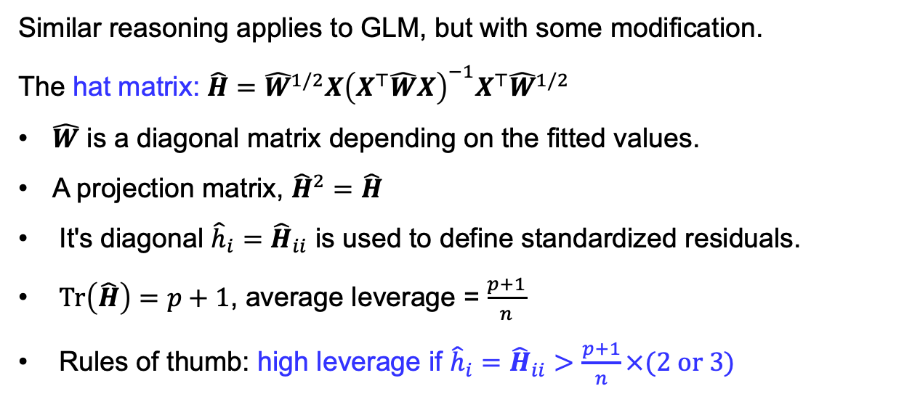
Leverage in GLM
Similar reasoning applies to GLM, but with some modification.
The hat matrix: $\hat{H}={\hat{W}}^{1/2}X{\left(X^{⊤}\hat{W}X\right)}^{−1}X^{⊤}{\hat{W}}^{1/2}$
$\hat{W}$ is a diagonal matrix depending on the fitted values.
A projection matrix, ${\hat{H}}^{2}=\hat{H}$
It's diagonal ${\hat{h}}_{i}={\hat{H}}_{ii}$ is used to define standardized residuals.
$Tr\left(\hat{H}\right)=p+1$, average leverage = $\frac{p+1}{n}$
Rules of thumb: high leverage if ${\hat{h}}_{i}={\hat{H}}_{ii}>\frac{p+1}{n}×(2 or 3)$
In R, use the function hatvalues() to obtain these leverage values for a fitted glm model object (though they are seldomly used alone).
Ultimately, we care about the influential observations with both high leverage and high residuals.

Slide 10
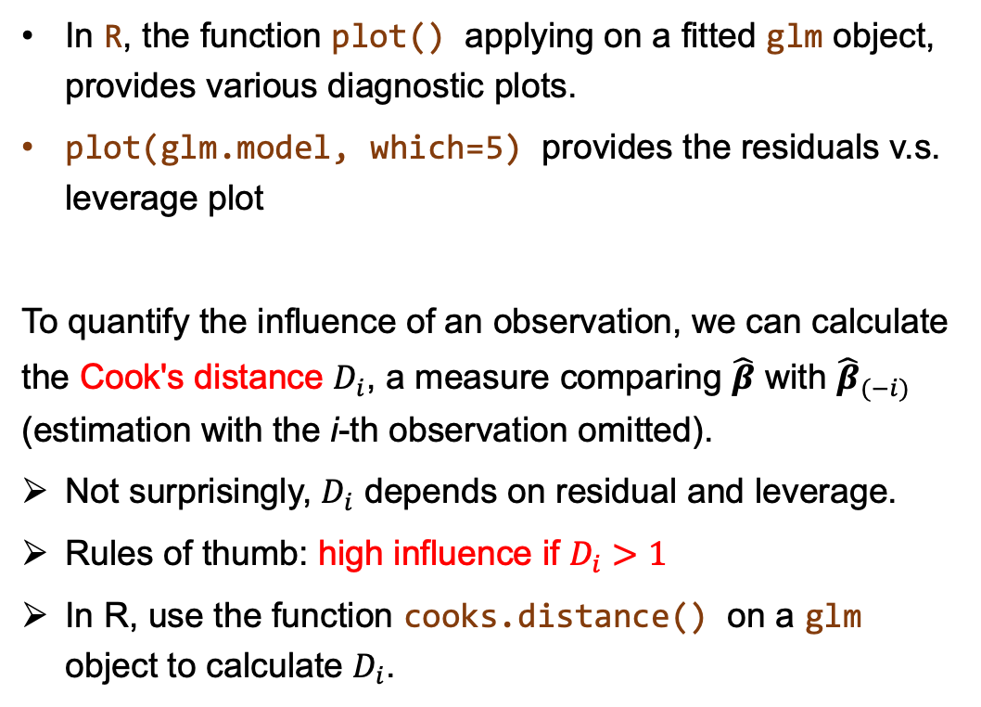
Influential observations
In R, the function plot() applying on a fitted glm object, provides various diagnostic plots.
plot(glm.model, which=5) provides the residuals v.s. leverage plot
To quantify the influence of an observation, we can calculate the Cook's distance $D_{i}$, a measure comparing $\hat{β}$ with ${\hat{β}}_{(−i)}$ (estimation with the i-th observation omitted).
Not surprisingly, $D_{i}$ depends on residual and leverage.
Rules of thumb: high influence if $D_{i}>1$
In R, use the function cooks.distance() on a glm object to calculate $D_{i}$.
The residuals v.s. leverage plot shows a Cook's distance contour.

Slide 11
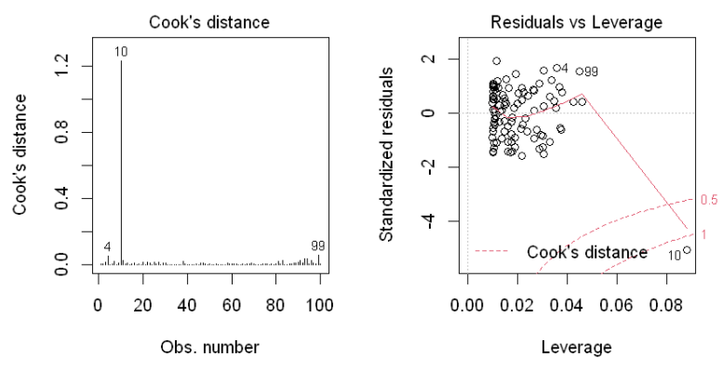
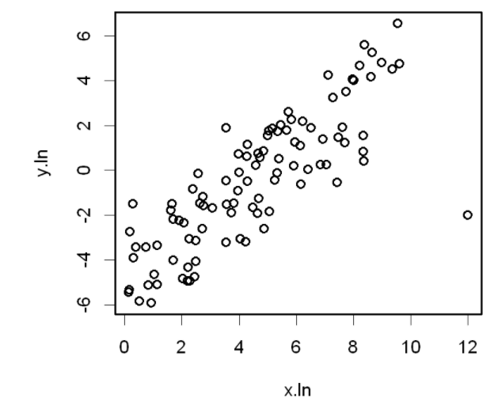
Influential observations — Plotting
It's more convenient to plot the Cook's distance out for checking. (Never a waste of time for checking Cook's distance !)

Slide 12
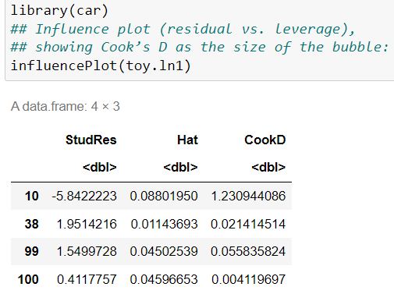
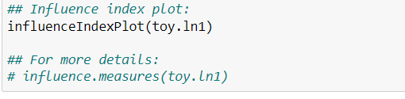
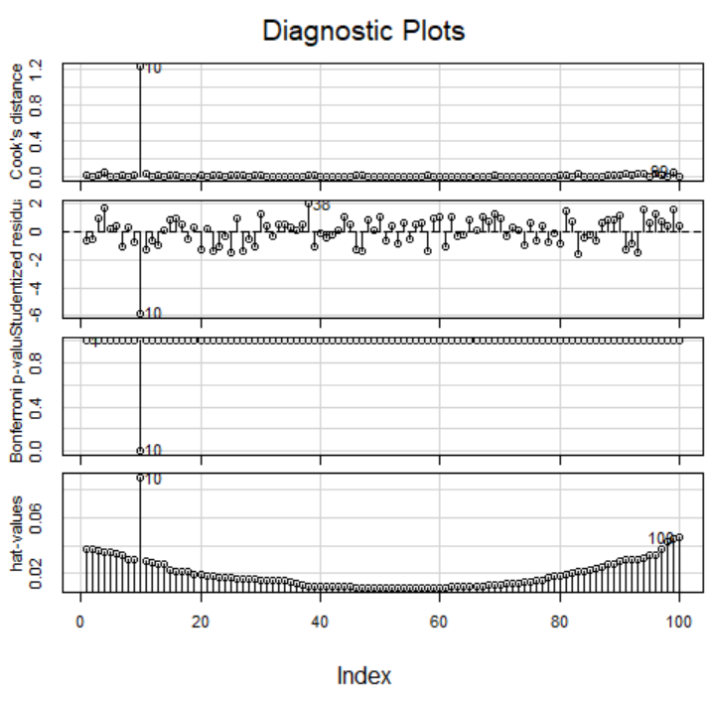
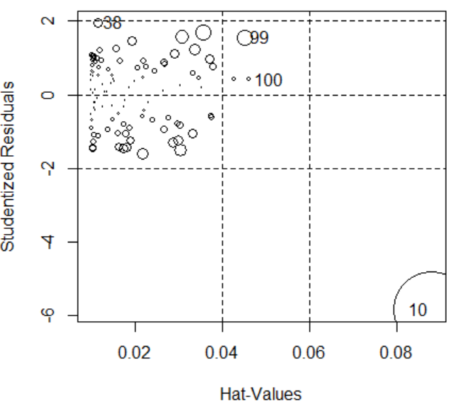
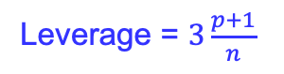
Influential observations — Plotting
The car package contains many enhanced functions for model diagnostic plots.
It prints out a few most influential points.
Standardized residual = 2 s.d.
Leverage = $3\frac{p+1}{n}$

Slide 13
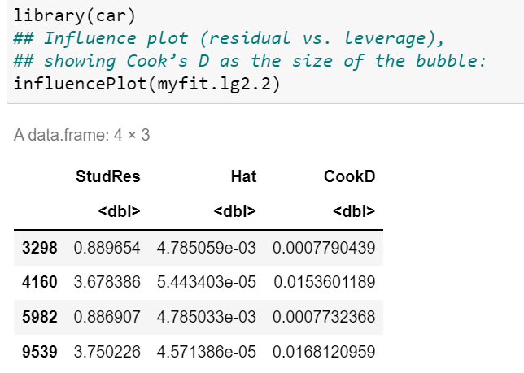
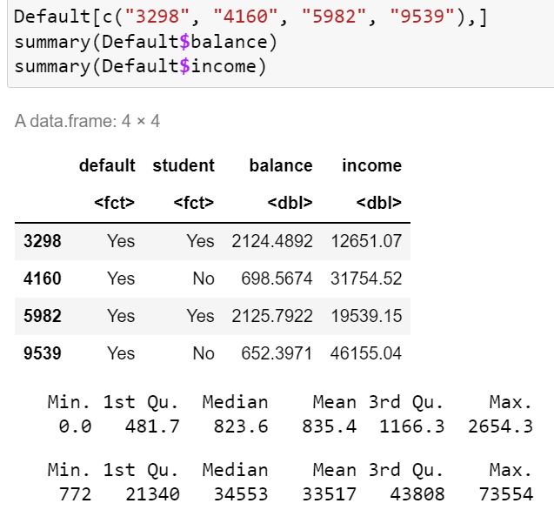
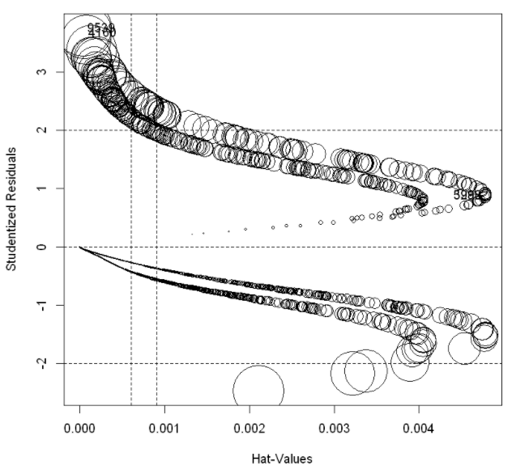
Example — Credit Card Default — Influential points
Logit model: myfit.lg2.2 => default=="Yes" ~ balance + student
Notes:
With many samples, it is easy to obtain some outlines just by chance.
3298, 5982: student with low income, but borrowed a lot of money.
4160, 9539: non-student with high income, but defaulted.

Slide 14
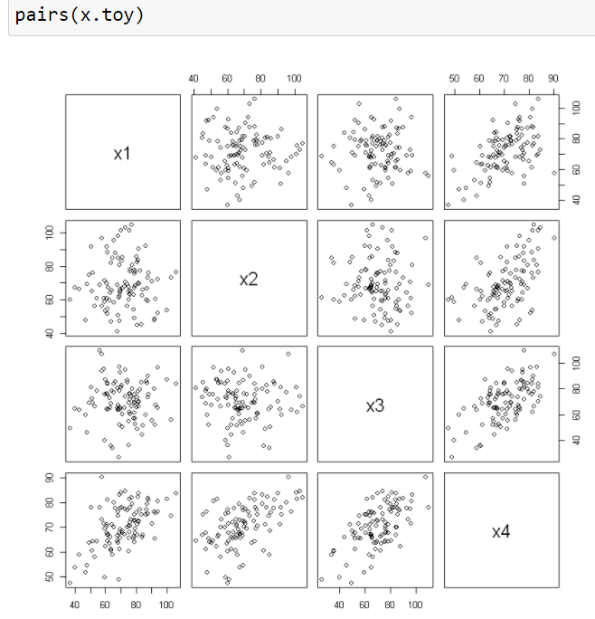
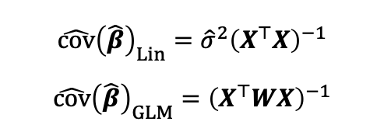
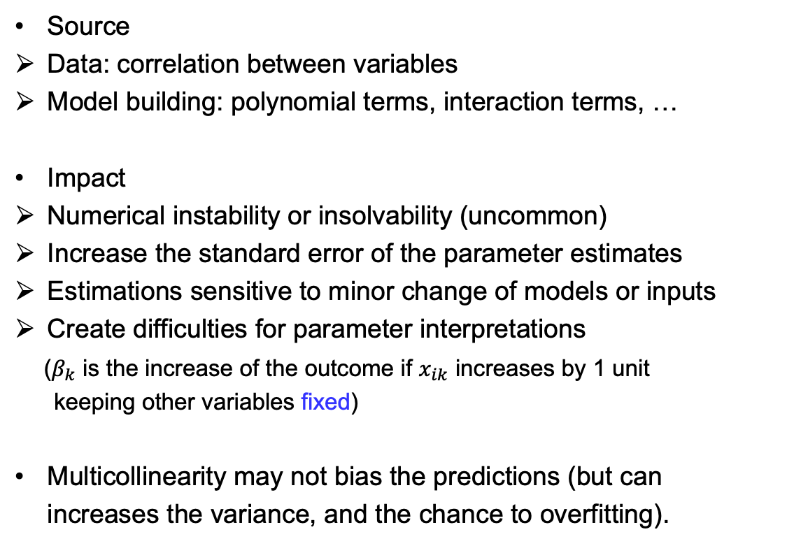
Multicollinearity — Relevance in all linear models
Source
Data: correlation between variables
Model building: polynomial terms, interaction terms, …
Impact
Numerical instability or insolvability (uncommon)
Increase the standard error of the parameter estimates
Estimations sensitive to minor change of models or inputs
Create difficulties for parameter interpretations
($β_{k}$ is the increase of the outcome if $x_{ik}$ increases by 1 unit
keeping other variables fixed)
Multicollinearity may not bias the predictions (but can increases the variance, and the chance to overfitting).
$$\hat{cov}{\left(\hat{β}\right)}_{Lin}={\hat{σ}}^{2}{\left(X^{⊤}X\right)}^{−1}$$
$$\hat{cov}{\left(\hat{β}\right)}_{GLM}={\left(X^{⊤}WX\right)}^{−1}$$
Notes:
Intuition: X^T * X has one or a few small eigenvalues,
Their inverse are very large, lead to large variance of parameter estimates.

Slide 15
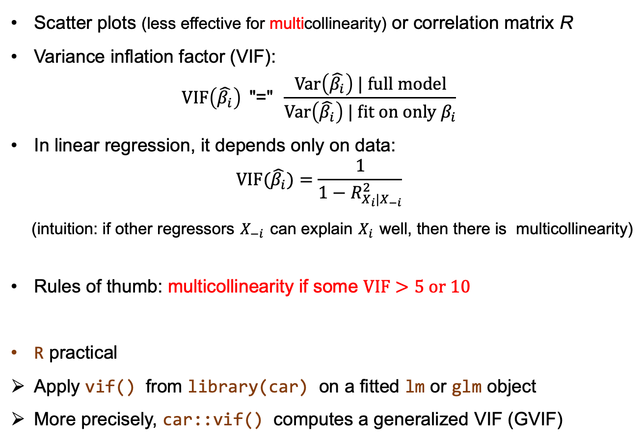
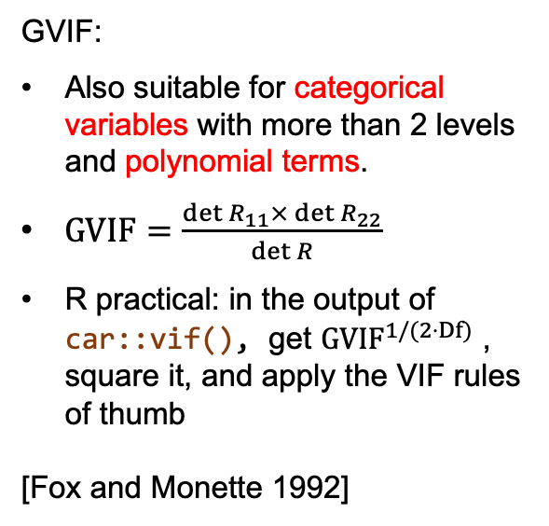
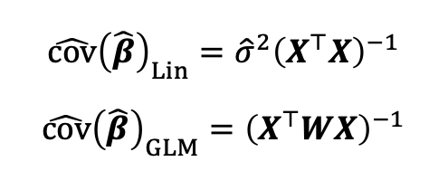
Multicollinearity — Detection
Scatter plots (less effective for multicollinearity) or correlation matrix R
Variance inflation factor (VIF):
$$VIF\left(\hat{β_{i}}\right) \text{"="} \frac{Var\left(\hat{β_{i}}\right) | full model}{Var\left(\hat{β_{i}}\right) | fit on only β_{i}}$$
In linear regression, it depends only on data:
$$VIF(\hat{β_{i}})=\frac{1}{1−R_{X_{i}|X_{−i}}^{2}}$$
(intuition: if other regressors $X_{−i}$ can explain $X_{i}$ well, then there is multicollinearity)
Rules of thumb: multicollinearity if some $VIF>5 or 10$
R practical
Apply vif() from library(car) on a fitted lm or glm object
More precisely, car::vif() computes a generalized VIF (GVIF)
$$\hat{cov}{\left(\hat{β}\right)}_{Lin}={\hat{σ}}^{2}{\left(X^{⊤}X\right)}^{−1}$$
$$\hat{cov}{\left(\hat{β}\right)}_{GLM}={\left(X^{⊤}WX\right)}^{−1}$$
GVIF:
Also suitable for categorical variables with more than 2 levels and polynomial terms.
$GVIF=\frac{\det{R_{11}×\det{R_{22}}}}{\det{R}}$
R practical: in the output of car::vif(), get $GVIF^{1/(2⋅Df)}$ , square it, and apply the VIF rules of thumb
[Fox and Monette 1992]
Notes:
VIF not applicable to categorical with more than 2 levels,
as they need more than one coefficients in the coding.

Slide 16
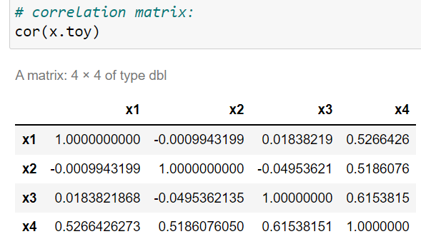
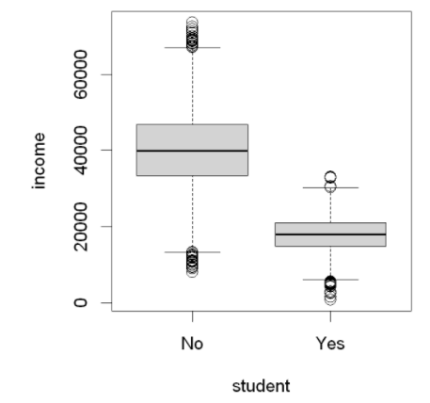
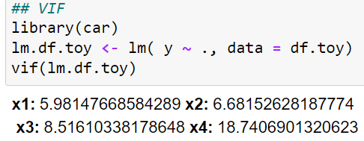
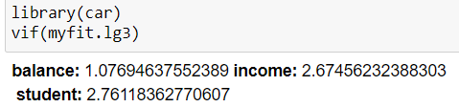
Multicollinearity — Detection
Full logit model of Credit Card Default
myfit.lg3:
default=="Yes" ~ balance + income + student
car::vif() on a fitted lm or glm object

Slide 17

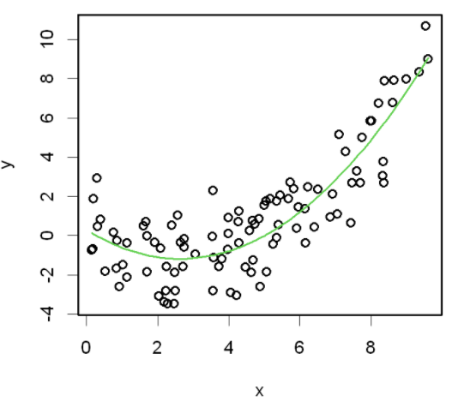
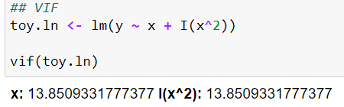
投票
最多可选1项
Would you take any action if you observe the following ?
Green: fitted curve
A
Yes
B
No
提交

Slide 18
Multicollinearity — Action
Do nothing
If the observed multicollinearity comes from model building (unless pathological)
Green: fitted curve
If multicollinearity is not too strong, and you just care about prediction, but not parameter interpretation (in the Default data, keeping income in myfit.lg3 is fine)
myfit.lg3:
default=="Yes" ~ balance + income + student

Slide 19
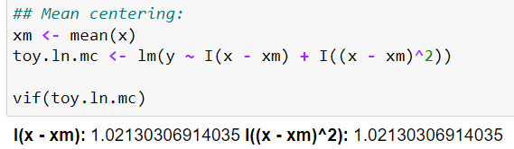
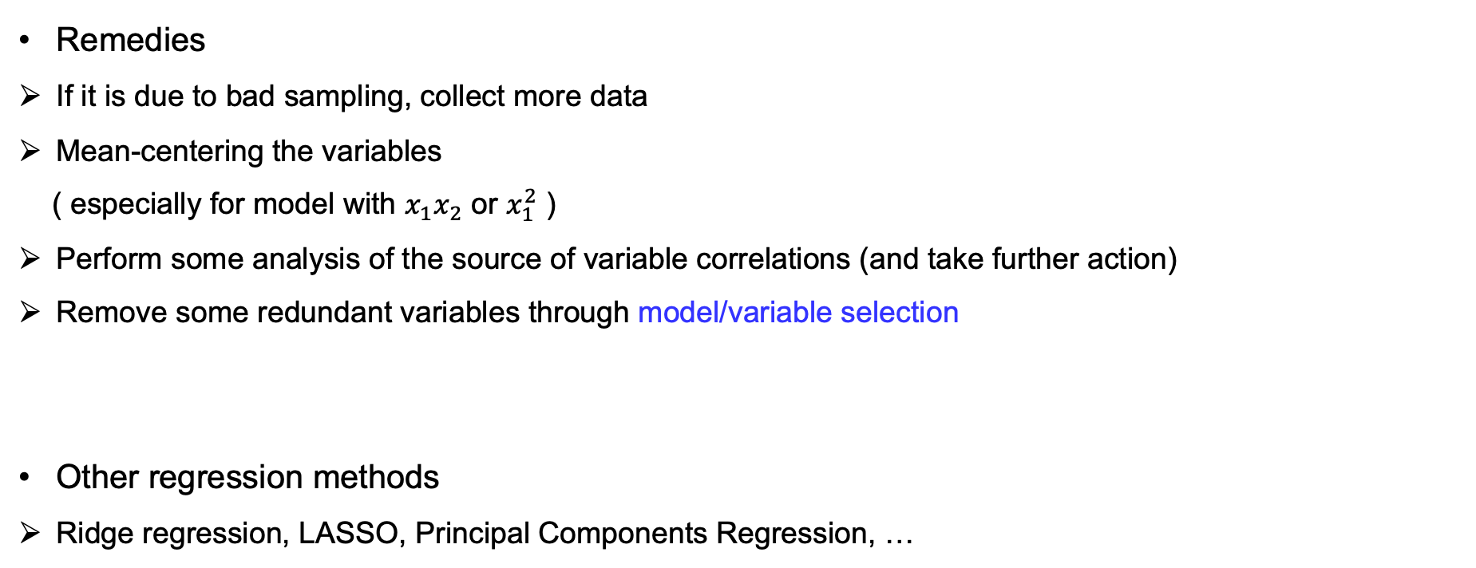
Multicollinearity — Action
Example of the previous page
Remedies
If it is due to bad sampling, collect more data
Mean-centering the variables
( especially for model with $x_{1}x_{2}$ or $x_{1}^{2}$ )
Perform some analysis of the source of variable correlations (and take further action)
Remove some redundant variables through model/variable selection
Other regression methods
Ridge regression, LASSO, Principal Components Regression, …

Slide 20




Model Selection
We usually want a balance between goodness-of-fit of existing data and simplicity of the model, if we believe the data generating mechanism is not complex.
Plots of polynomials having various orders M, shown as red curves.

Slide 21



Model Selection — Conventional wisdom
We have used the AIC, BIC as measures for model comparison, which trade off goodness-of-fit and and model complexity ( $AIC=2k−2\log{lik}$, $BIC=k\log{n}−2\log{lik}$ )
This is because more complex models must fit the existing data better, but generally have a higher variance (also aesthetically not preferred…).
For prediction, we care more about the generalizability to unseen data.
Due to the high variance, a very complex models can have a high test error.
Notes:
AIC: coding, information loss; BIC: posterior prob of models.
Complex model -> high variance: as they fit to noise,
When a different sample is obtained, the regression can be very different.
Best to get to the sweet spot of the trade-off.

Slide 22



Perspective from recent developments – Just make models larger ?
On ImageNet
ResNet18 on CIFAR10 [P. Nakkiran et al, 2019]
Double descent phenomenon
Contradictory to traditional bias-variance trade-off?
Not well understood yet

Slide 23


Model Selection — Estimating generalization
Back to the classical regime…
Instead of achieving the sweet spot of generalization indirectly through a complexity penalty, can we estimate the generalization error more directly ?
Reserve a small part of training samples as the validation set -> to estimate generalization error
K-fold Cross-validation:
($K=n$ : leave-one out cross-validation (LOOCV))
validation set
Good: useful everywhere!
Drawback: variability is higher for small sample size
R practical: use cv.glm() function from library(boot)
Do not touch the test data during training!

Slide 24



Model Selection — Practice
Selection criteria
cross-validated pred. error, AIC, BIC
adjusted $R^{2}$ for linear regression
Some methods
Best subset selection
$\left({p+1 \atop k}\right)$ choices (without interactions)
In R, leaps::regsubsets() for linear regression; bestglm::bestglm() for GLM
Stepwise selection
Forward, backward, hybrid
In R, use step() or MASS::stepAIC()
Forward steåpwise selection
Backward stepwise selection
Keep in mind that, stepwise selections are greedy methods, which can easily lead to sub-optimal solution.
Theory, common sense, domain knowledge are also useful for model building.
Notes:
Do not rely on data to tell you all the story.

Slide 25


投票
最多可选1项
Do you think it a good idea to rely on the significance (t-test or Wald test) of regression coefficients to select variables ?
A
Yes
A linear regression
B
No
A logistic regression
提交

Slide 26





Pitfalls in variable selection using significance of coefficients (Optional)
Linear regression as an example:
$H_{0}: β_{i}=0$, the (Wald) test statistic has the form
Observations
A larger ${\hat{β}}_{i}$ has a larger test statistic (larger effect), more significant.
Smaller noise and larger sample size (bigger data) tend to make a variable significant (how well we can measure it).
But such statistical significance does NOT imply the usefulness for prediction (think about the difference between statistical significance and effect size).
A larger $\hat{Var}[X_{i}]$ (data more widely spread on the i-th dimension) tends to make ${\hat{β}}_{i}$ significant.
A larger ${VIF}_{i}$ (more correlation with other coefficients) makes ${\hat{β}}_{i}$ less significant.
Take significance of coefficients as a hint and investigate further, but not evidence.
$$\hat{cov}{\left(\hat{β}\right)}_{Lin}={\hat{σ}}^{2}{\left(X^{⊤}X\right)}^{−1}$$
$$\hat{cov}{\left(\hat{β}\right)}_{GLM}={\left(X^{⊤}WX\right)}^{−1}$$

Slide 27


Example — Titanic
The Titanic was billed as the ship that would never sink. On her maiden voyage, she set sail from Southampton to New York. On April 14th, 1912, at 11:40pm, the Titanic struck an iceberg and at 2:20 a.m. sank. Of the 2228 passengers and crew on board, only 705 survived.
Let's build a model to predict survival.

Slide 28




Example — Titanic — Preprocess

Slide 29


Example — Titanic — Preprocess
Here I omit the rows with missing data for simplicity.
Note that there are many rows with just age missing; so there can be a better way to deal with it.

Slide 30


Example — Titanic — Preprocess
Notice in the raw data, some attributes use (0,1), some uses (1,2,3)…
As we care about prediction in this case, reserve some samples as test data

Slide 31



Example — Titanic — Logit models by stepwise-AIC

Slide 32


Example — Titanic — Logit models by CV (a much simplified demo)
Their difference is not so big...

Slide 33



Example — Titanic — Logit model after some explorations

Slide 34




Example — Titanic — Performance on test data
Here, the ROC curve is evaluated using test data.

Slide 35




Example — Titanic — Diagnostic
Notes:
Cook’ D is fine.
94: age 80, male but survived.

Slide 36


Example — Titanic — Diagnostic
Multicollineartity:
pclass has three categories, so $GVIF$ and $GVIF^{1/(2⋅Df)}$ are calculated.
Some $GVIF^{1/(2⋅Df)}$ is larger than $\sqrt{5}=2.236$
But our model is built with interactions, so this is acceptable.
Centering age if necessary.

Slide 37

Example — Titanic — Other stories
Do you have an idea of a better model?
Is nationality a main contributing factor? Or can it be explained by other factors?
The dataset happens to have this attribute.
What model would you choose to investigate this question? Log-linear? Logit?
What structure would you like to check primarily? High-way association? Conditional independence?

